Slide 1
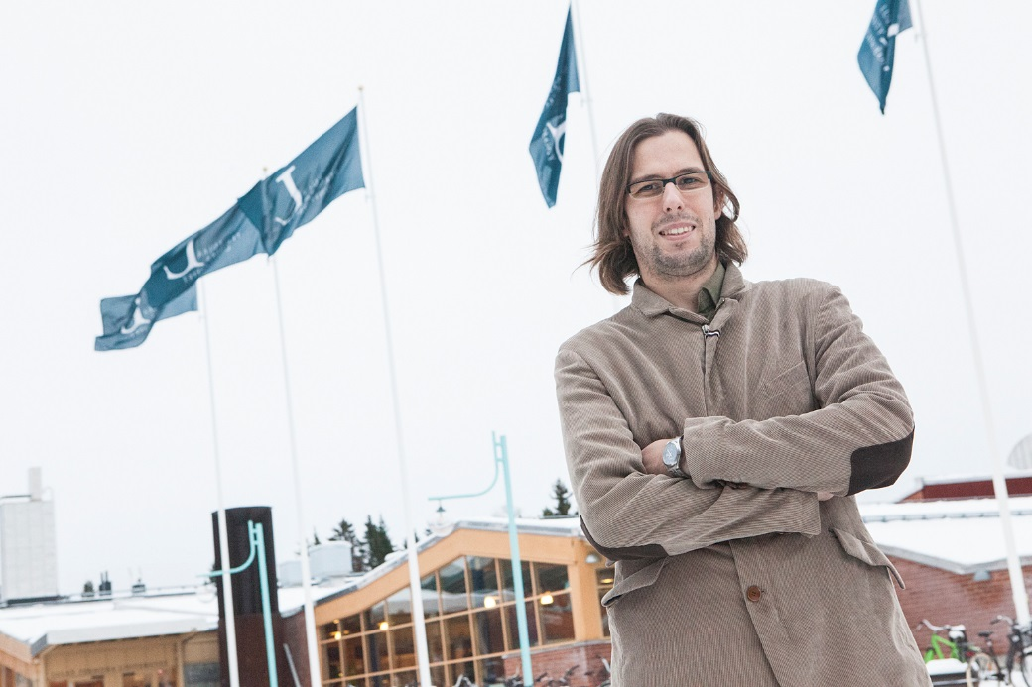

Feature Extraction for eMaintenance of Runestones
Miguel Castaño Arranz

Slide 2
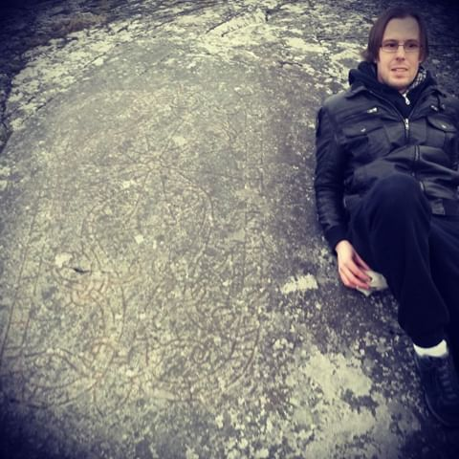
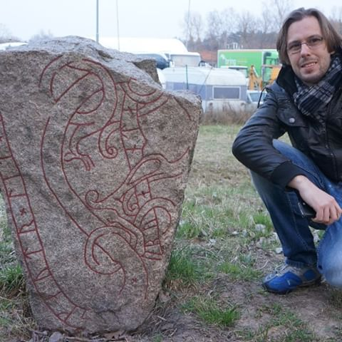
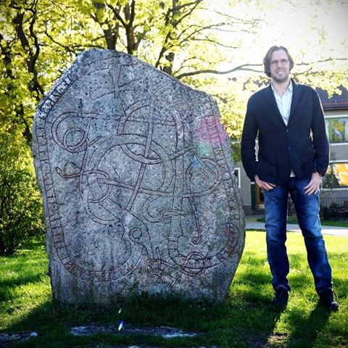
Maintenance of Viking runestones
Sweden has around 2500 runestones which date from 9th-12th century
They are an important part of Swedish heirtage.
Most of them lay precisely where they were raised.
Information is very scarce. Lack of digitalization
Maintenance performed by local teams who visit the runestones often
Usual Maintenance actions:
Cleaning from moss, funghi and other growth
Cleaning surroundings
Repainting the carvings
Maintenance actions depend on many factors such as stone material
Three kinds of maintenance actions
Restorative. E.g. broken stone
Preventive. E.g. cleaning
Artiscic. Repainting carvings
Challenges
Condition monitoring from crowdsourced pictures
AR & XR for Virtual Reconstruction

Slide 3
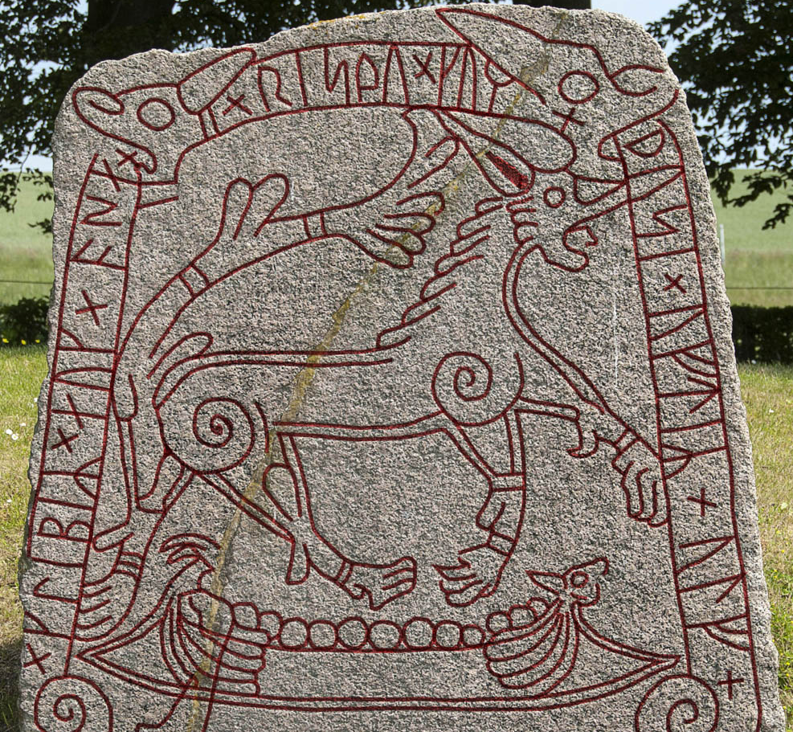
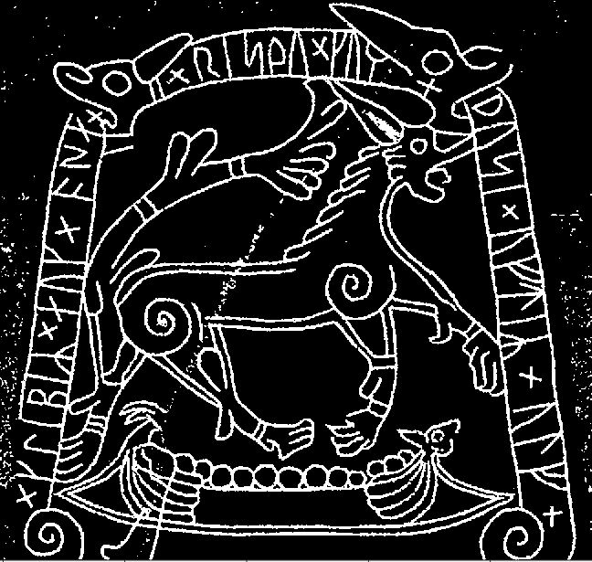
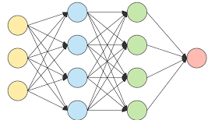
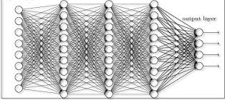
Feature Engineering Vs Feature Learning
Feature Engineering refers to the use of domain knowledge to extract Features
Raw Data
Features
Shallow ML architecture
Feature Engineering
Maintenance Pescription, e.g.:
Paint carvings
Clean moss growth
Feature Learning refers to the use of deep learning to extract features from raw data. Features can be extracted e.g. from intermediate layers of Neural Networks
Features
Raw Data
Deep Network Architecture
Maintenance Pescription, e.g.:
Paint carvings
Clean moss growth

Slide 4

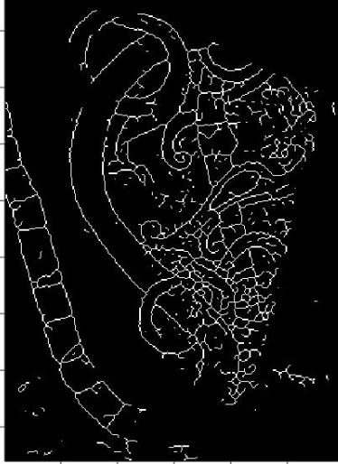
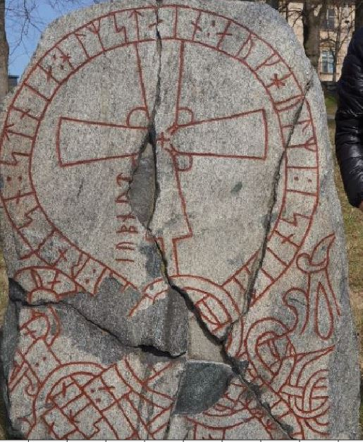
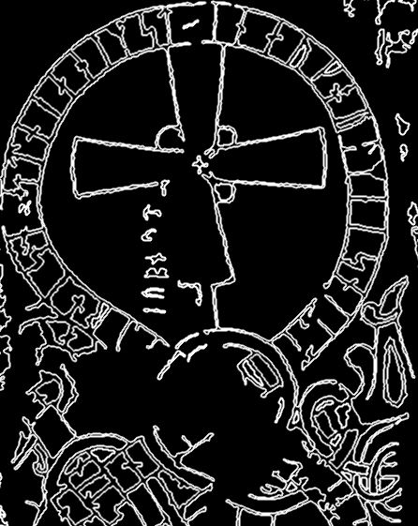
Results in Feature Engineering for Runestones
The precise tuning which gives good features for a runestone might not give good features for another runestone.
The features will be used for traditional machine learning algorithms

Slide 5
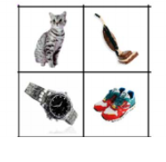
Results in feature learning
Learned Features Features
Your database
from layers
Traditional learning algorithms
Prescription
Extracting features
Runestone U47
Transfer Learning
Repurposed Alexnet
Classification
Runestone Sö142
Runestone Ö31
Transfer Learning
Deep Learning
Deep CNN such as AlexNet
Large Scale databse on another domain

